Slide 1
Adult learning in a time of austerity - England
Alan Tuckett
University of Wolverhampton
ESRC seminar
12 February 2016

Slide 2
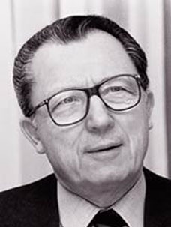
The Treasure Within
Jacques Delors argued in The Treasure Within
that there are 4 pillars for a learning society
learning to know
learning to do
learning to be
learning to live together

Slide 3
OECD’s PIAAC Findings - England
Overall literacy levels in England – close to the international average, whilst numeracy levels are much weaker
Uniquely 16-24s are no more skilled than 55-64s and
16-18s have lower skills than 55-64s
Age cohort that has highest skills went to school in the Plowden era
Qualifications are no guarantee of secure basic skills:
10% of undergraduates and 7% graduates have low basic skills
Basic skills are strongly related to parental education in England
Weak basic skills strongly associated with rising levels of inequality

Slide 4
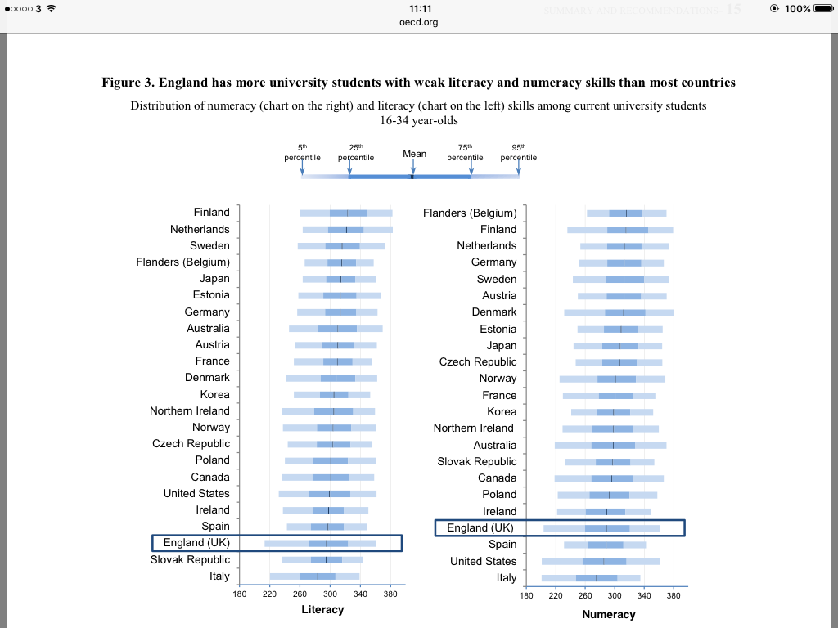

Slide 5
What has the government in England done 2010-15?
Post school funding:
Higher education:
26% budget increase 2010-2015
Further education:
24% budget decrease 2010-2015.
And:
Cut requirement for qualified teachers in FE; end of obligation to undertake 30 hours CPD;
Ended Skills for Life programme; systematic ESOL cuts (offset by 2016 Cameron initiative);
Introduced levy on medium/large employers.

Slide 6
International comparisons

Slide 7
Mean instruction hours spent by participants in education and training, age 25-64 (2007)

Slide 8
Adults participating in learning by social class 2015

Slide 9
Future intentions to learn by current/recent engagement in learning (%)
Likely to take up learning Unlikely
Current learners 83 17
Current and recent learners 77 23
No learning last 3 years 23 77
None since school 17.5 82.5 (unpublished data NIACE 2015)

Slide 10
UK part-time HE entrant trends by UK country index (2010 = 100)
Source: Figure 15, ‘Pressure from all sides: Economic and policy influences on part-time higher education’, HEFCE

Slide 11
Employers offering training UK
Table 1
% of employers training staff over the last 12 months/ offering off-site training
2003 59 n/a
2004 64 47
2005 65 46
2007 67 46
2014 58 45
(LSC 2008, 3, UKCES 2014, 56)

Slide 12
The more you’ve had the more you get

Slide 13
Funding apprenticeships: levy!

Slide 14
After PIAAC: OECD recommendations for England
Priority of priorities: give priority to early interventions;
Increase basic skills at upper secondary
Divert unprepared students from HE; shift resources from HE to FE
Improve transitions to work and promote upskilling at work
Use evidence to support adult learning

Slide 15
EAEA Manifesto for adult learning in the 21st century
Adult education has a role to play in:
Active citizenship, democracy and participation
Life skills for individuals
Social cohesion, equity and equality
Employment and digitalisation
Migration and demographic change
Sustainability
European policies

Slide 16
UN/UNESCO agenda
No one left behind
Education for sustainable development
Education for citizenship
‘Learning to live together’
Learning cities
Inter-generational learning/ ageing society:

Slide 17
Guardian ‘masterclasses’: fine if you can afford them/live in London

Slide 18
Learning cruises/ fun if you can afford them

Slide 19
U3A/ voluntary self-help Mainly for already confident learners?

Slide 20
Men’s sheds – just beginning

Slide 21
Mass Open Online Courses – ideal for some

Slide 22
Learning through Life: Weaknesses in the system
Initial education does not serve as a secure foundation for lifelong learning.
The demographic challenge: the balance of opportunity and support for learning through different stages of life is wrong.
The system does not recognise the increasingly diverse transitions into and from employment.
Educational inequalities accumulate over the life course to an unacceptable extent.
For all the rhetoric, a high-skilled economy is not yet in prospect.
The governance of the system is over-centralised, insufficiently stable and does not trust its professionals enough.
The ‘system’ is not sufficiently intelligent.

Slide 23
Overall
Public policies reinforce the privilege of the privileged: if at first you don’t succeed…
Public support focused on narrow utilitarian goals
Levy offers modest hope
Voluntary sector initiatives modest at best
Still, like ground elder it’s hard to eradicate altogether

