Slide 1
Routes: How will VET reforms impact upon HVET? 29th June 2016
David Corke, Director of Education & Skills Policy, AoC
Mike Potter CBE, Principal and CEO of Guildford College Group

Slide 2
The question!
The world has seen an explosion in the number of universities and university students, often to the detriment of established high quality vocational pathways.
In England, degree-related individual and government debt are spiralling, alongside fast-declining rewards for many graduates.
Is it possible to create a sizeable high-quality vocational pathway that will help tackle this situation? Yes, it has been done elsewhere.
Or is our English tertiary system simply out of control? No, but we need to consider carefully how these reforms are implemented.

Slide 3
Policy Context

Slide 4
Market based policy reform in the name of productivity
Further centralisation of 16-19 education through qualification and accountability reforms.
Decentralisation/Devolution of 19+.
Levy – Marketisation of apprenticeships (employers) and the 3m target.
Loans – Marketisation (and extension) of loans (individuals).
HE reforms. Degree Apps. H Apps. TEF, etc.
Institutes of Technology.
Area Based Reviews.
Is the routes reform programme any different?
How will these reforms impact upon HVET?
Notes:
Questions:
Are we heading towards a system like Australia’s (TAFE – 2005 onwards), just without the sunshine?
What is the intent regarding private and employer providers?
Will we see a reduction in portability (19+ flexibilities and apprenticeship standards)? Is this a big problem?
Where is the room for local influence?
HVET defined as 3+.

Slide 5
Routes reform: Nordic examples

Slide 6
Sainsbury Review
If they are

Slide 7
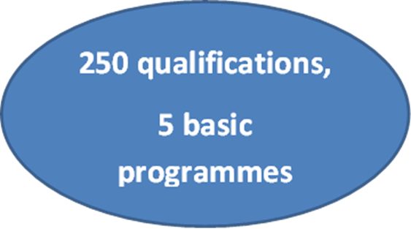
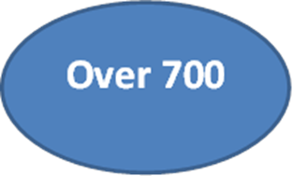
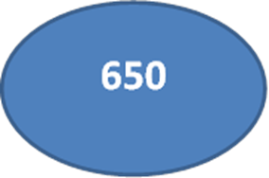
The development of Finnish VET: Qualification structure and number of specifications
1980s
1970s
1960s

Slide 8
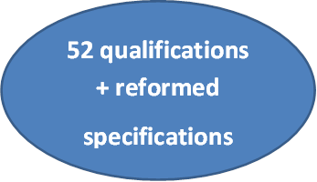
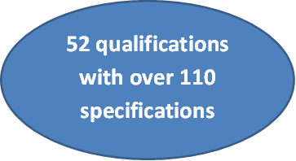
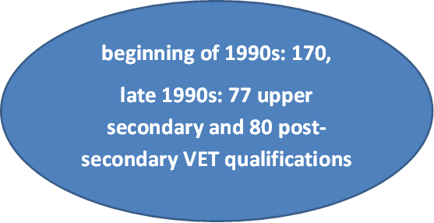
Qualification structure and number of specifications
2010s
2000s
1990s
Notes:
Austria Vocational Schools, amazingly well resourced. Middle class going to voc, rather than academic
Distinctive because it is different.

Slide 9
Distinctive institutions, routes and accountability

Slide 10
Distinctive accountability/institutions
Distinctive because they are different.
‘To make these routes distinctive we:
need distinctive accountability measures that do not treat institutions and individuals as homogenous.
need to run distinctive technical routes in well resourced colleges only.
need a distinctive culture and pedagogy.
need distinctive forms of technical scholarship.
need more regulated routes.
Notes:
We will simplify the current over-complex system by introducing up to 20 new TPE routes from schooling to skilled employment. Current thinking 15 routes:
Childcare and education Hair and beauty Protective services
Finance, accounting & legal Construction Retail & customer service
Hospitality & catering Health & science Transport & logistics
Engineering & manufacturing Digital Social care
Business & admin Creative and design
Agriculture, environment and animal care
These will be genuinely owned by employers who will specify the technical knowledge, practical skills and behaviours they require, in line with reformed apprenticeships.
The new TPE routes will shift the focus away from a system driven by qualifications to one that develops and certifies occupational competence.
One AO per route?

Slide 11
Distinctive accountability/institutions
‘Continuing to emphasize that very stringent individual school and FE accountability will lift system performance – despite that there exists no real evidence that it has’ (Cappon, 2015).
Notes:
We will simplify the current over-complex system by introducing up to 20 new TPE routes from schooling to skilled employment. Current thinking 15 routes:
Childcare and education Hair and beauty Protective services
Finance, accounting & legal Construction Retail & customer service
Hospitality & catering Health & science Transport & logistics
Engineering & manufacturing Digital Social care
Business & admin Creative and design
Agriculture, environment and animal care
These will be genuinely owned by employers who will specify the technical knowledge, practical skills and behaviours they require, in line with reformed apprenticeships.
The new TPE routes will shift the focus away from a system driven by qualifications to one that develops and certifies occupational competence.
One AO per route?

Slide 12
Accountability issues…

Slide 13
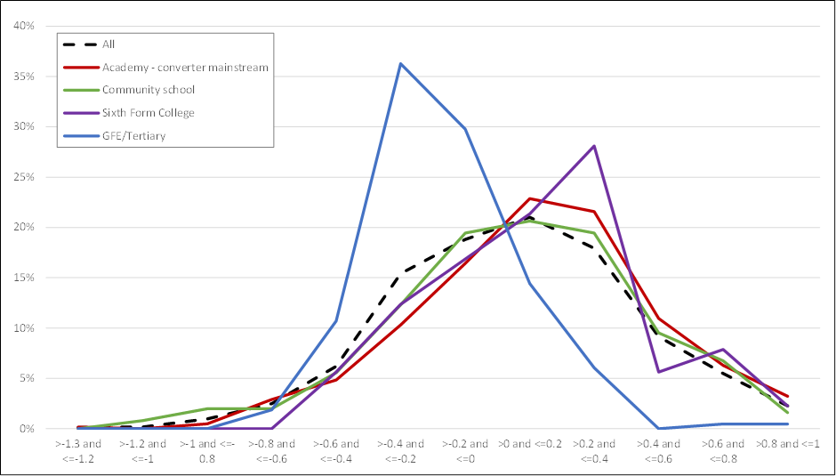
Vocational Value Added

Slide 14
GCSE English and maths QoE
National KS4 rate is 57% for both.
Lowest LEA is 36% for both.

Slide 15
Questions :
In reality, how strong do you think the correlation between not having English and maths and a weak VA score is?
Consider:
Student 1: 5 GCSEs A* to C including English and Maths
Or
Student 2: 5 GCSEs A* to C excluding English and Maths
How strict should entry to TPE programmes be?
What thoughts do you have with regards to a transition year?
What does it mean to be made to resit?
What does all this mean for a ‘Common Inspection Framework’ across inspection remits?
Should the reformed TPE programmes be run in schools?
Should the programmes or accountability measures be the same for all institution types?

Slide 16
Policy intent, implications and questions?
Massification of HE relied on BTEC (26% of entrants according to UCAS).
Will these programmes be accepted by academic HE?
Will the TPE reforms damage supply in to academic HE?
FDAP/DAP: Do we need to need to see more distinctive class and work-based routes in HVET?
What is the intent with short cycle qualifications?
Will we see a growing plethora of apprenticeship standards (383). Shifting away from L2/3.
Brand stretch with regards to ‘Higher’ and ‘Degree Apprenticeships’?
Will we see greater vertical integration, ex-polytechnics moving downstream or colleges becoming moving upstream to become IoTs?
Notes:
Will the TPE reforms damage supply in to academic HE? Is this a good thing?

Slide 17
Implications for HVET

Slide 18
Higher Vocational Pathways & Progression Practitioner’s Perspective – Issues
Too narrow a focus on progression to prescribed HE
Widen debate to include structure of labour & HE markets, productivity and supply & demand for skills within wider discussions on social mobility
Skills shortages persist with mismatch between supply & demand; many occupations do not need three year degree
Gross imbalance between what is spent on HE and adult skills and declining part time HE sector
Colleges supply 1/3 HE students; 29% from most deprived areas and 39% who come to College with <5 GCSEs A*-C achieve L3 qualifications; 38% progress to HE – c. 87k
Half of Adv. Apprentices who progress to HE, do so in Colleges
System not in crisis but needs reform – more TPE skills, greater focus on employers/employment, replacement L4&5 workforce and simplify to meet numbers and quality aspirations

Slide 19
Higher Vocational Pathways & Progression Practitioner’s Perspective – Challenges/Opportunities
HE Bill, White Paper, TEF, Sainsbury Review – all opportunities but will they deliver?
Regulatory framework – College established providers in HE are different – TDAPs/FDAPs
Choice drives up quality – does it? Symmetric information
Quality Assessment Review and Employer Engagement
Higher & Degree Apprenticeships; Levy – SME solution?
Institutes of Technology - more distinctive routes to HVET?
Widening Participation and refocusing of SO funding
English, Maths & Value Added – Ofsted focus and impact
Area Based Reviews
Glass is ‘half-full’ not ‘half-empty’ – lots of opportunity for those prepared to grasp it but watch for unintended consequences

Slide 20
Routes: How will VET reforms impact upon HVET? 29th June 2016
David Corke, Director of Education & Skills Policy, AoC
Mike Potter CBE, Principal and CEO of Guildford College Group

