Slide 1

Strengths and weaknesses in the school-based model of IVET: transitions to HE and working life in Finland
ESRC-funded seminar series, HIVE-PED:
Higher Vocational Education and Pedagogy in England/
Maarit Virolainen

Slide 2
Finnish Institute for Educational Research, FIER
A national centre for educational research, established in 1968
A multidisciplinary research institute based
at the University of Jyväskylä
Mission: to develop education
through scientific research
Research areas:
  Educational systems and society
  Education and the world of work
  Learning, teaching and
  learning environments

Slide 3
Contents
I The development of Finnish provision of IVET in relation to the education system
II The Finnish model compared to other Nordic countries:
transition to working life and higher education
III Present challenges and the future of the Finnish IVET

Slide 4
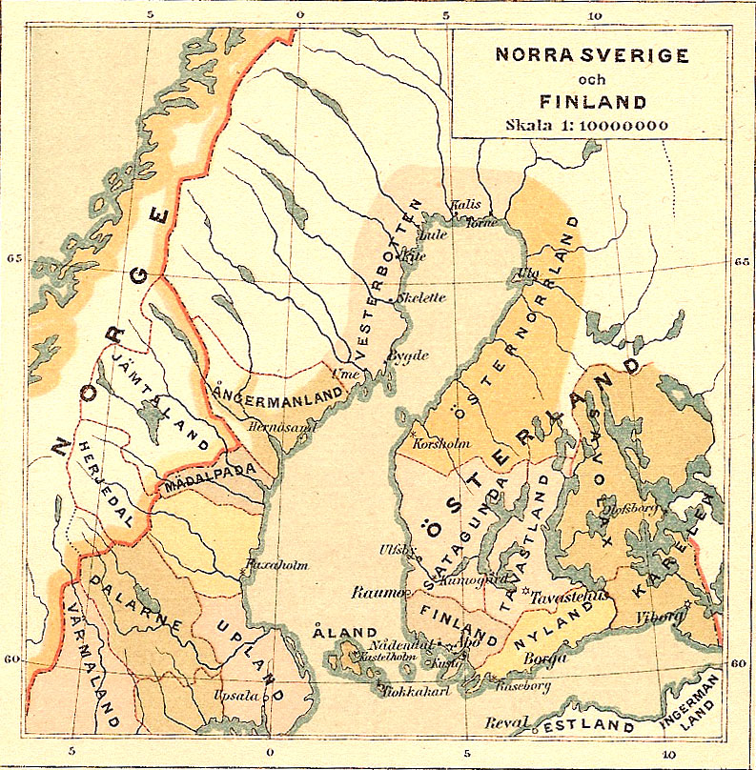
Some historical turning points
Part of Sweden until 1808:
(Götaland, Svealand,
Norrland and Österland).
Part of Russia
1809-1917
Became independent
in 1917
World war II

Slide 5
Side-step:Nordic dimension in the Finnish culture
Proportion of Swedish-speakers in Finnish population
has decreased from 13% (in 1900) to >6% (in 2013)
At present the size of Swedish-speaking minority (5,4% in 2014) is as big as other minorities in sum, around 300 000
Emigration to Sweden in 1960s and 1970s in particular-> 440 000 Finns or children of Finns in Sweden (in 2008), if grandparents counted 675 000
Total population in Finland is around 5,500 000.

Slide 6
Guilds, masters, apprentices in the 19th century
the work force was given the freedom to choose their living
and work places as a result of new legislation passed in 1879
->urbanisation
Establishment of first vocational schools e.g.
-Schooling for seafaring started in 1813,
-schooling for health care and midwifery in 1816,
-first business college was established in 1839,
-the first agricultural college in 1839,
-the first technical real colleges in 1847,
-and the first forestry college in 1861

Slide 7
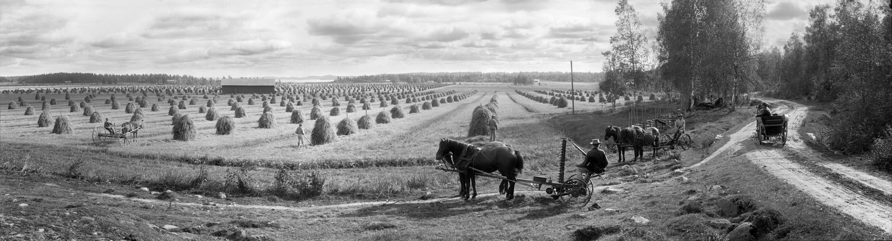

Shift from agricultural to industrial society enhanced after World War II

Slide 8
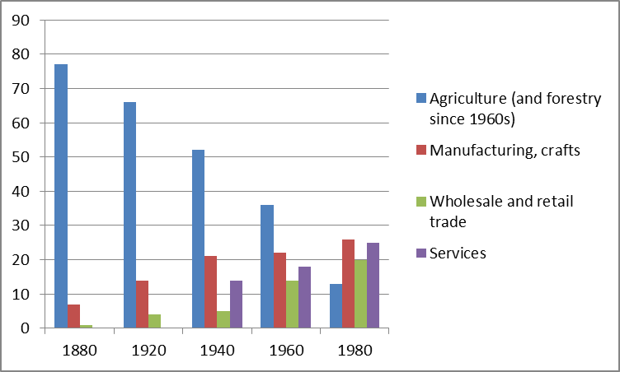
From agricultural to industrial society, and service society

Slide 9
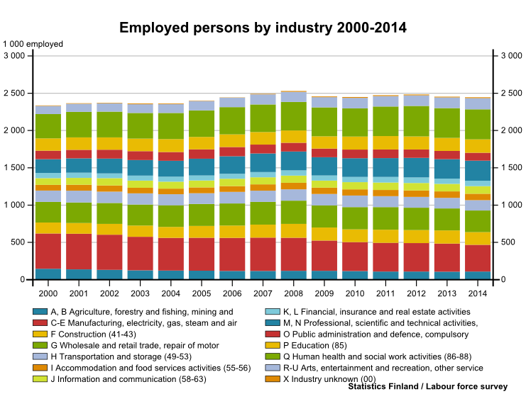
Human health and social work activities
Professional, scientific and technical activities
Wholesale and retail trade
Manufacturing

Slide 10
VET and the shift
Law 1958: all municipalities of more than 20,000 inhabitants to have a vocational school and smaller municipalities to reserve study places for their youngsters at these schools
Enhancement of school-based VET, to meet the needs of urbanisation, population growth and new emerging fields
(->shifts in production, emerging welfare state)

Slide 11
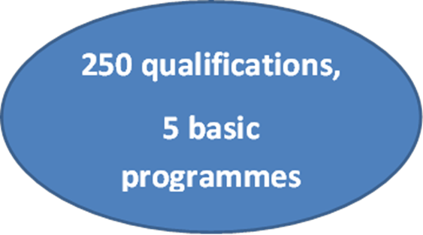
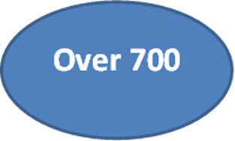

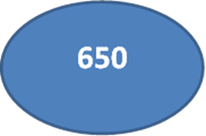
The development of Finnish VET: Qualification structure and number of specifications
1980s
1970s
1960s

Slide 12
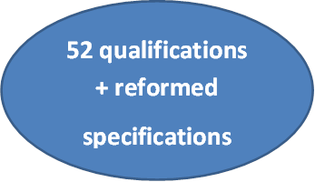

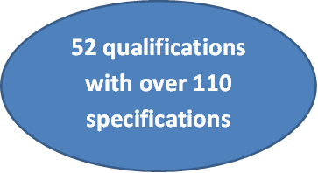
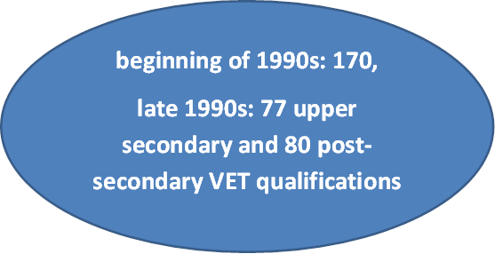
Qualification structure and number of specifications
2010s
2000s
1990s

Slide 13
The development of Finnish VET: further and higher education opportunities
1960s and 1970s: no access
1980s: parallel 2- and 3-year qualifications, only 3-year qualification gave eligibility to HE
1990s: eligibility to higher education
2000s, 2010s: eligibility, individualisation, work-based learning

Slide 14
The development of Finnish VET: Changes in curriculum (general or/and vocational component)
1990s: Modularization of curriculum, flexibility and individual choice, development of internships in post-secondary VET. Polytechnics replace post-secondary VET; their curriculum developed to a higher level. All IVET qualifications extended to last 3 years (120 study credits).
2000s: Three-year VET gives eligibility to UAS and traditional universities. On-the-job learning and skills demonstrations adopted in curriculum since 2001.
2010s: Competence-based approach adopted since August 2015. A shift from study credits to competence points. Harmonisation with ECVET system in order to “enhance mobility and life-long learning”.

Slide 16
What happened to participation in VET with respect to participation in general upper secondary studies?
Direct transition to VET increased 2005– 2012

Slide 17
Some reasons behind increased participation in VET:
development of VET towards the world of work during the last decade; adoption of on-the-job learning and skills demonstrations,
skills competitions, like the annual Finnish National Skills Competition 'Taitaja‘; improved prestige
international exchange programmes,
eligibility to higher education that VET offers,
enhanced higher education opportunities: establishment of universities of applied sciences in the 1990s
individualised study programmes, enhanced provision of VET as part of inclusive youth policies in order to keep youth active-> provision of VET as part of welfare state policy aiming to equality

Slide 18
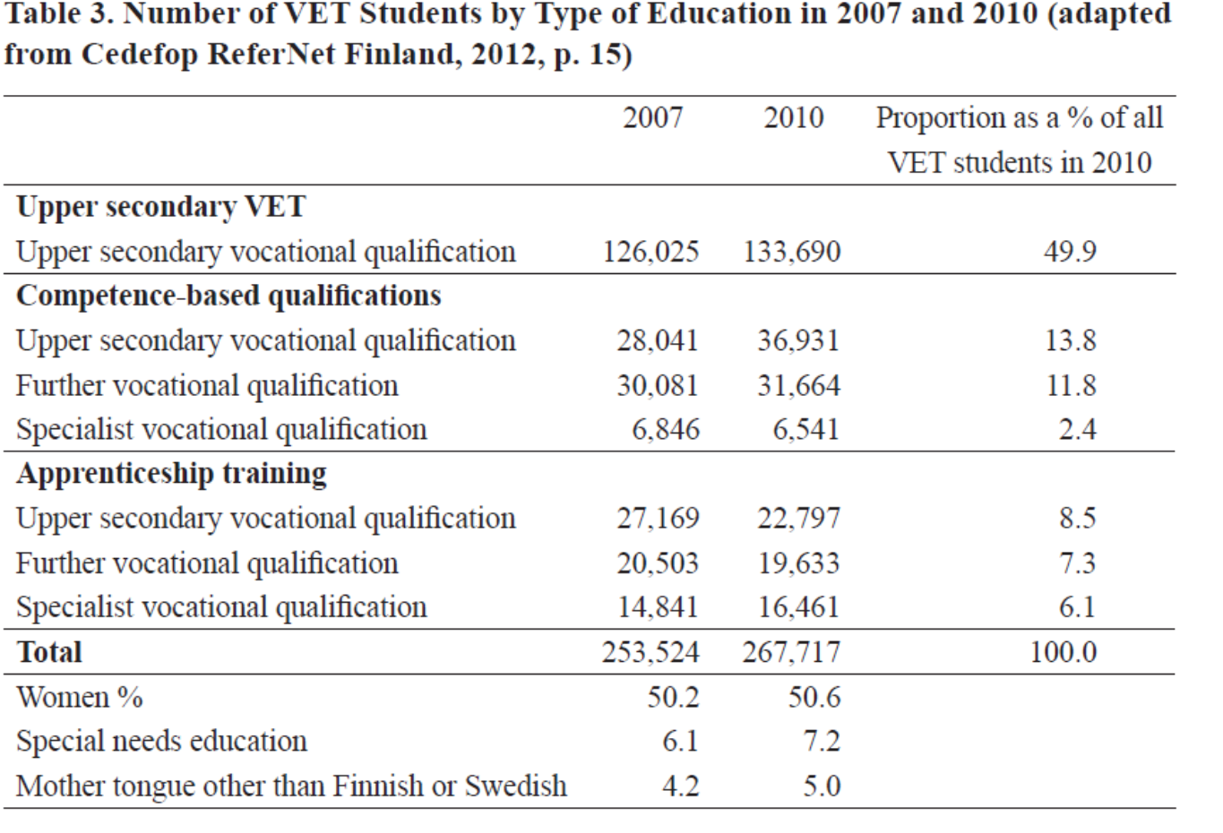
What happened to apprenticeship training ?

Slide 19
II The Finnish model compared to other Nordic countries: participation, transition to working life and HE
Since 1999/2000 participation in VET has increased in Finland
and Sweden;
It has decreased in Denmark and Norway and UK and Germany
(Paper: Table 2)
-> Despite increased participation, transitions to working life have not been quite as succesfull as in other countries (Paper: Table 3),
why?

Slide 20
II The Finnish model compared to other Nordic countries: expansion of HE and transition to HE

Slide 21
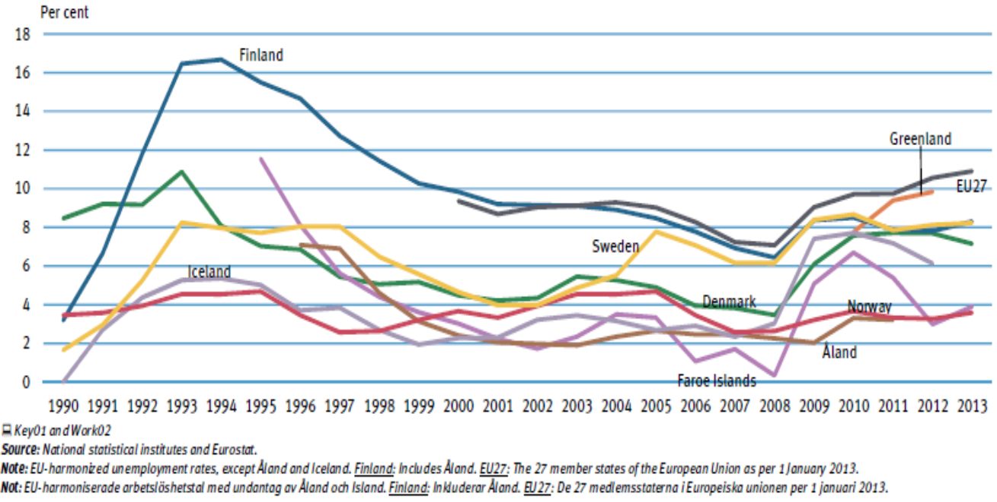
Why employment from Finnish VET is worse than in other countries?

Slide 22
Transitions from VET to HE
Eligibility to HE and the establishment of UAS is reflected in relatively high level of participation compared to Denmark and Norway (Table 4)
Comparisons of Nordic VET confirm that transition patterns to HE and to the world of work are :
country and field specific,
dependent on the linkages between education system and labour market and how transition system has developed with respect to that particular occupation/vocation/profession
More and more dependent on global economy and development, provision of skilled labour force

Slide 23
Present challenges and the future of the Finnish IVET
Diverse student population: from ambitious Skills competitors, completors of double qualifications to second chance students (youth guarantee)
Dropping out, decreased from 13% (in 2000/2001) to 9% (in 2012)
Recession -> financing of VET
Restructuring of the network of upper secondary education providers and regional accessibility
Reorganisation of adult and youth education
Urbanisation: curriculum renewal
Immigration: language studies

Slide 24
Share of foreign citizens in EU-27 countries (%) in 2011

Slide 25
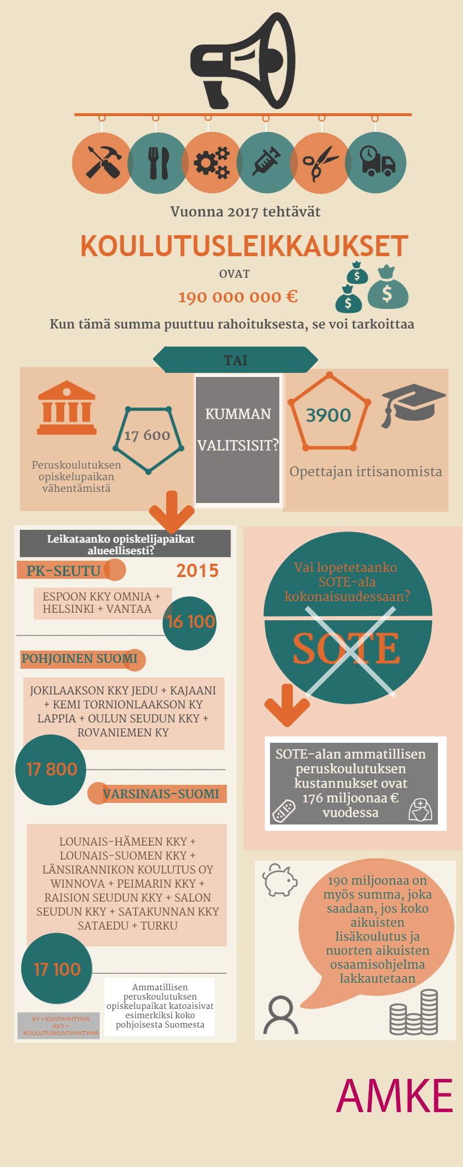
Financing of VET
How the Finnish Association for the
Development of Vocational Education
and Training AMKE ry has tried to picture
The effect of financial
cut-backs introduced recently:

Slide 26
Thank you for your interest!
ktl.jyu.fi/en

