Slide 1
University of Greenwich and UCL Institute of Education Friday 13th May 2016
ESRC HIVE-PED
Research Seminar Series
Professor Jill Jameson
Professor of Education , University of Greenwich
Director, Centre for Leadership and Enterprise
Professor of Education , University of Greenwich
Notes:
1

Slide 2
Seminar Eight Higher Vocational Education: Parity and Success Friday 13th May 2016 UCL Institute of Education 10.00 – 15.40 20 Bedford Way, London WC1H 0AL

Slide 3
Seminar Eight: Overview
A chance to reflect
consider research evidence
debate alternatives

Slide 4
ESRC Research Series Vision: 'HIVE-PED: Higher Vocational Education and Pedagogy in England 2013-16’ * nine expert research seminars/ events * three overarching research themes: * parity, progression and social mobility

Slide 5
Series sub-themes * Parity, vocational pedagogy, leadership * Democratic citizenship * Progression to HE, social mobility * Professionalism, HIVE qualifications * Pedagogy: changing ‘training culture’ * Student success, motivation, trust, drop-out

Slide 6
Contextual factors: * dysfunctionalities, complexities of system * policy: FE, HE, adult, employers, govt * challenges ££ cuts, global competition * ‘training without jobs’/robbery issues * stratification of elites, social inequity * UK-EU-international models, patterns

Slide 7
BUT creative potential of new research and partnerships
New understanding vocational pedagogy, andragogy, Makerspaces, HE Apprenticeships
longitudinal tracking; data mining
Facilitators of; barriers to progression more identifiable: target removal of barriers
Collaboration, innovation: UK-wide,EU/ global provider-funder-employer partners
Notes:
11:45-11.48
20

Slide 8
The Series so far ..2013-14
The HIV-PED Seminar Programme
Dates: 2013–14 | Seminar
4 October 2013 | Conference BIS Conference Centre, London Journeys to Higher Education Programme and presentations
28 February 2014 | Seminar One University of Greenwich Higher Vocational Education Programme and presentations
23 June 2014 | Seminar Two University of Birmingham Parity, progression, social mobility: critical issues for higher vocational ed pathways Presentations Programme and Papers
10 October 2014 | Seminar Three University of Greenwich Apprenticeships and Progression Programme and Papers

Slide 9
The Series so far ..2015-16
The HIV-PED Seminar Programme
Dates: 2015-16 | Seminar
6 March 2015 | Seminar Four City & Guilds, London, University of Greenwich: Crafty work: re-forming, re-making, re-thinking vocational and technical education 2010-2015 Programme and presentations
30 October 2015 | Seminar Five University of Huddersfield International Perspectives on Policy, Pedagogy and Practice in Higher Vocational Education Programme
12 February 2016 | Seminar Six University of Wolverhampton Adult Learning in a Time of Austerity
4th March 2016 | Seminar Seven Linking London: Birkbeck College, London Perspectives on Higher Voc Education in London Programme

Slide 10
..the Series rounds up… 2016
Dates: 2016 | Seminar
13 May 2016 | Seminar Eight UCL Institute of Education, U College London Higher Vocational Education: Parity & Success
29 June 2016 | Policy Colloquium King's College, University of London The ESRC HIVE-PED Project: Research
30 September 2016 | Seminar Nine University of Greenwich: Devonport House The ESRC HIVE-PED Project: Seminars Overview
October 2016 onwards | Publications and MOOC All partners with key institutions

Slide 11
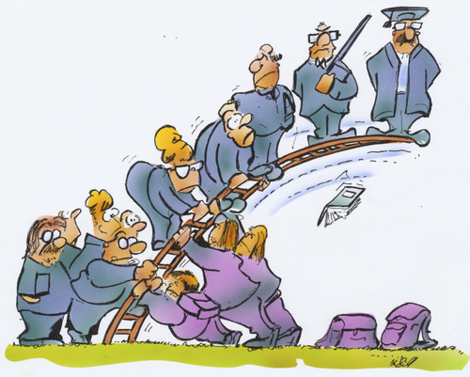
Supporting HIVE success

Slide 12
Strategic thinking/decision making
Tactical alignment of progression partners
Consider new partnership strategies
Make decisions/goals based on data
Allocate resources to achieve planned goals
Key alliances of partnerships
Notes:
11:45-11.48
20

Slide 13
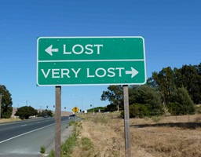
What’s happening to/within higher vocational education?
Direction of travel for ‘FE and skills’
Notes:
12.43
35

