Slide 1
Adult learning and Austerity in Scotland
Adult Learning in a Time of Austerity
University of Wolverhampton
12 February 2016

Slide 2
Where we are starting from
Wider ‘crisis’ in adult learning policy
Patchy representation of learner interests
Social expectations of education and employability
Political emphasis on measurement and performance
College system in transition
University system combative over governance reform
Institutions seeking ‘low maintenance learners’

Slide 4
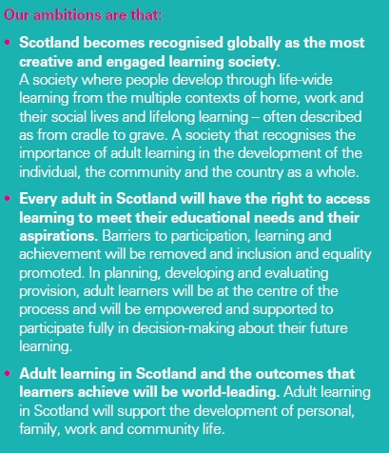

Slide 5
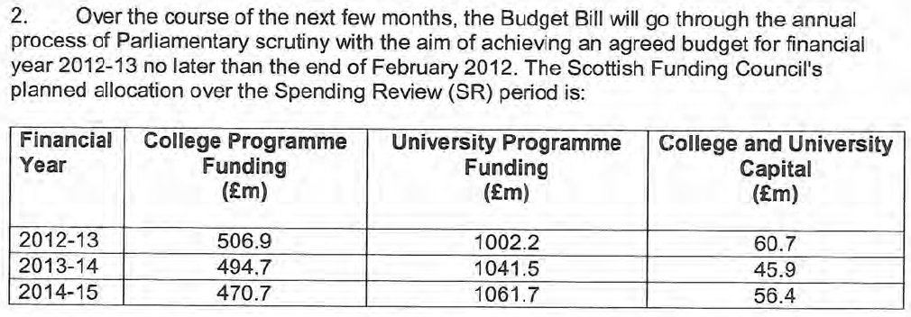
Letter of guidance to SFC, 2011

Slide 6
Four priorities for colleges
Guarantee for all 16-19s (and for 20-24 “where possible”)
Improved retention rates
Courses and qualifications “fit for purpose”
Organisational savings and focus on outcomes
Letter of guidance to SFC, 2011

Slide 7
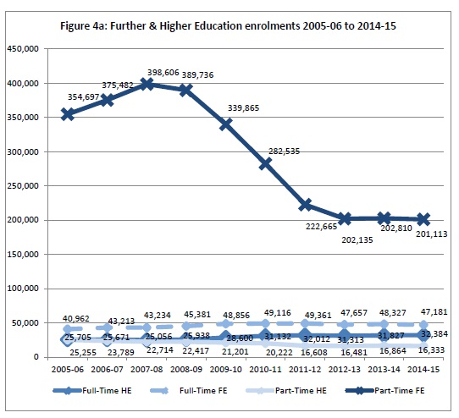

Slide 8
Scotsman, 30 July 2015

Slide 9
Full-time mature students at Scottish HEIs

Slide 10
Part-time undergrads at Scottish HEIs

Slide 11
Not all bad news?
Overarching policy framework for adult learning still under development
Clear and well established policy framework for literacies
ESOL strong (particularly for full-time students and ‘learners of white European origin’ - ES, 2014)
Some continuities (including ILAs, ULF) from The Learning Age
Skills policies aligned with aims for equality and poverty reduction
Growth of informal learning around the independence campaign?
Healthy demand in the private and self-help sectors

Slide 12
The main reason to be cheerful (or at least thoughtful)
None of the issues that repeatedly provoke debate over lifelong learning, and have done so increasingly urgently since the 1960s, has gone away.
On the contrary: they have accelerated.

