Slide 1
TERTIARY EDUCATION IN CRISIS What role for higher vocational provision?
Alison Wolf
King’s College London

Slide 2
A tale of two sectors

Slide 4
Real income since 2001/02, UK universities £bn, 2008 prices

Slide 6
Teaching-only staff as proportion of total

Slide 7
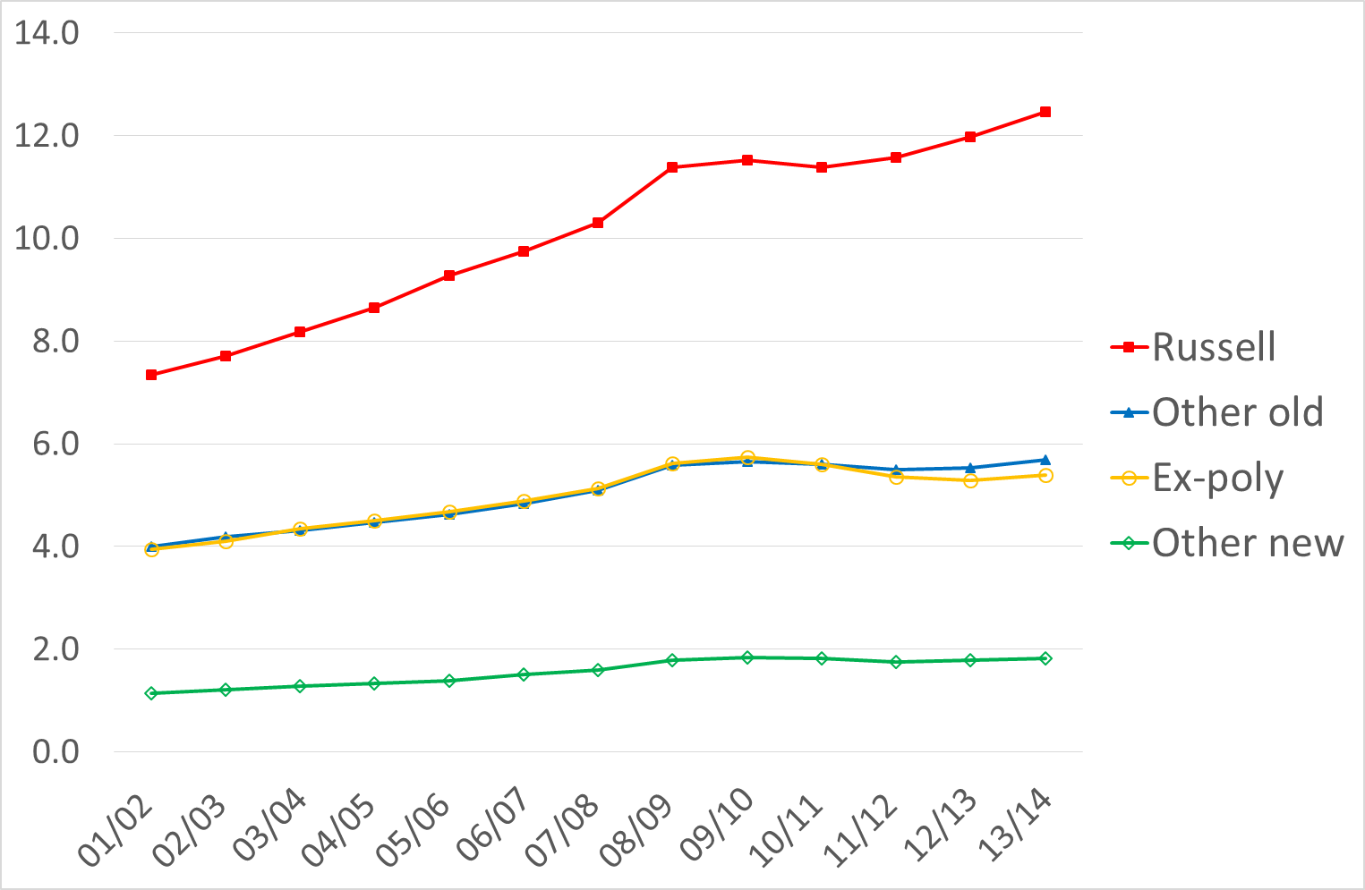
Real income since 2001/02, by type, UK universities £bn, 2008 prices

Slide 11
No drop off in HE participation as a proportion of age group
‘Every 18 year old with a level 3 will of course go on to uni’ (Head of an adult education agency 2016_

Slide 12
Vast increase in higher education enrolments a global phenomenon

Slide 13
Funding HE
While some countries in Europe have maintained low ‘user-charges’ across a large system, this is increasingly uncommon
Fees
Loans
Growth of private providers

Slide 14
Huge variability in ‘returns’ to UK higher education
For some subjects and some institutions, median earnings 10 years after graduation are far higher than for non-graduates
For some subjects and some institutions, median earnings after graduation are no higher than for non-graduates

Slide 15
Other countries show the same pattern
USA, Taiwan, Poland…

Slide 16
‘BIS is all set to become the largest financial institution in Europe’
In England, soaring debt totals and much of this will never be repaid

Slide 17
Our model is extremely expensive
It is also unusually uniform. Single sector where all institutions do everything, and tiny stable numbers for HE in FE

Slide 18
The normal pattern is segmented
Netherlands
Canada
France
Germany

Slide 19
Vocational higher education has huge pedagogical advantages
But it will only succeed with the right financial and institutional structures

