Slide 1
Progression to Higher Education from London FE and 6th Form Colleges
Hugh Joslin
ESRC HIVE-PED Project, Centre for Leadership and Enterprise,
Faculty of Education and Health, University of Greenwich

Slide 2
LEVEL 3 ACHIEVERS FROM LONDON COLLEGES
Level 3 achievers
Longitudinal – progression patterns over time​
Demographic – age, gender, ethnicity, deprivation​
Programme – previous provider & programme​
Destination – university or FE college programme​
Achievement – of First degrees and class of honours ​
GCSEs – prior Key Stage 4 attainment​
​
Tracked
HESA – prescribed HE
ILR Level 4+ -non-prescribed HE
DfE KS4 attainment

Slide 3
221,500 London college students
2007-08
(42,060)
2008-09
(44,140)
2009-10
(46,085)
2010-11 (42,835)
2011-12 (46,380)
108,050 to Higher Education
2009-10
2008-09
2010-11
2011-12
2012-13
Notes:
We started with a English cohort of 1.8 million FE Level 3 students across the 5 years and linked these students across 5 years of HE datasets. We should note that there were 2 unusual years in HE included in this study: 2011 where we had a increase in HE student numbers due to the number who chose not to defer before the 2012 fee year when numbers dipped. You will see that in total, across all HE we found a total of 795K in HE. You will remember that this is both non prescribed HE and prescribed HE so all Level 4 and above provision.

Slide 4
London college students progression
Cohort described
Age, gender, ethnicity
Geography (borough)
Progression to HE
Progression rates and timing
HE delivery (University or HE in FE)
FE qualification
Disadvantage
HE mode
HE subjects
HE Success Rates
Prior attainment at KS4

Slide 5
Characteristics of the college cohorts in the study

Slide 6
Breakdown of qualifications studied
Level 3 Qualification Type
Access to HE
GCE A2 Level/IB
BTEC
NVQ
Other vocational

Slide 7
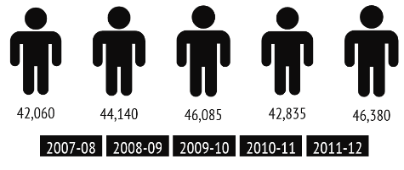
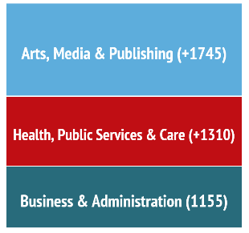
A description of the tracked Level 3 cohorts
Over 200,000 London FEC Level 3 students tracked….
8% more females
14% more males
+7,325
-3,055
Top Fifteen colleges in tracked cohort numbers 2011-12
City and Islington College
Westminster Kingsway College
Richmond upon Thames College
Ealing, Hammersmith and West London College
Barking College
Bromley College of Further and Higher Education
Havering College of Further and Higher Education
City of Westminster College
Kingston College
South Thames College
Lambeth College
Barnet College
Uxbridge College
College of North East London
Lewisham College
More young…
Less adults..
AND
Considerable growth in the population to three sector skills areas in particular (between 2007 and 2011)

Slide 8
Patterns of qualification take-up
 | 2007-08 |  | 2008-09 |  | 2009-10 |  | 2010-11 |  | 2011-12 |  | % growth
 | Cohort Number | % of Total Cohort | Cohort Number | % of Total Cohort | Cohort Number | % of Total Cohort | Cohort Number | % of Total Cohort | Cohort Number | % of Total Cohort
Access | 3995 | 10 | 4125 | 9 | 4845 | 11 | 5080 | 11 | 4935 | 12 | 24%
BTEC | 9650 | 23 | 10000 | 23 | 11615 | 25 | 14095 | 25 | 18660 | 33 | 93%
GCE A2 /IB | 9550 | 23 | 8950 | 20 | 8850 | 19 | 8945 | 19 | 8485 | 21 | -11%
GCE AS | 1170 | 3 | 930 | 2 | 815 | 2 | 1005 | 2 | 905 | 2 | -23%
NVQ | 4965 | 12 | 8980 | 20 | 9725 | 21 | 6715 | 21 | 2775 | 16 | -44%
Other Vocational | 12730 | 30 | 11160 | 25 | 10235 | 22 | 6995 | 22 | 10625 | 16 | -17%
Total | 42060 |  | 44140 |  | 46085 |  | 42835 |  | 46380 |  | 10%

Slide 9
London college students and disadvantage…..
Three in four Level 3 FE students classified as living in an area of disadvantaged using Income Deprivation affecting Children Index (IDACI Q1/Q2)
AND
Compared to
41%
41% Level 3 students from colleges in England classified as living in an area of educational disadvantage
of students classified as Black and Minority Ethnic (BME). BME students are much more likely to be younger than their White peers in London FE colleges

Slide 10
Disadvantage profile of Level 3 college cohort by borough (combined cohort)
All Boroughs | IDACI
 | Quintile 1 | Quintile 2 | Q3 | Q4 | Quintile 5
TOTAL | 51% | 25% | 13% | 8% | 7%

Slide 11
London Boroughs with highest levels of disadvantage in their level 3 college cohorts (combined)
Boroughs | IDACI
 | Quintile 1 | Quintile 2 | 1 plus 2
Barking and Dagenham | 67% | 29% | 96%
Brent | 60% | 32% | 92%
Camden | 72% | 16% | 88%
Greenwich | 59% | 30% | 89%
Hackney | 86% | 13% | 99%
Haringey | 81% | 11% | 92%
Islington | 87% | 8% | 95%
Lambeth | 72% | 22% | 94%
Lewisham | 57% | 34% | 91%
Newham | 97% | 3% | 100%
Southwark | 74% | 19% | 93%
Tower Hamlets | 97% | 2% | 99%
Waltham Forest | 62% | 32% | 94%
Notes:
Averages Q1-75%; Q2 19%; All colleges over 85% average of q1 and q2 - 94%

Slide 12
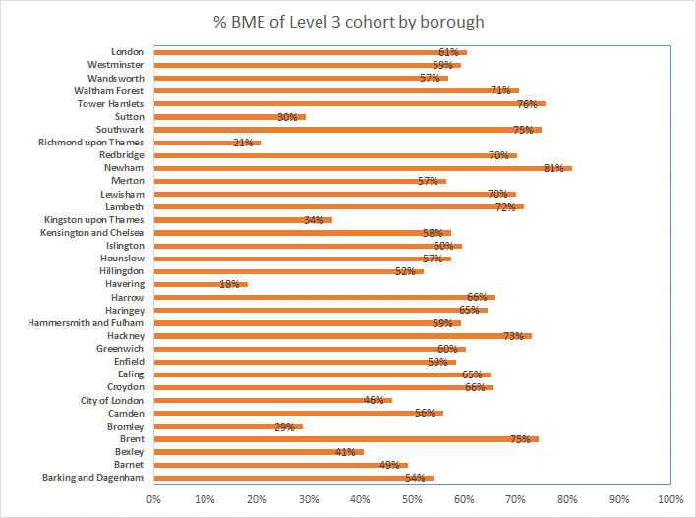
Breakdown of London Boroughs by ethnic group of the college cohorts

Slide 13
Progression to higher education

Slide 14
HE progression for each of the five college cohorts
FE Cohort Year | Population | Into HE |  |  |  |  |  |  |  |  | Immediate entry to HE (following year) |  | Progression to HE all tracked to date
 |  | 2008-09 | 2009-10 |  | 2010-11 |  | 2011-12 |  | 2012-13
 |  | Number progressing |  |  |  |  |  |  |  |  | Number | % | Number | % | Years tracked
2007 | 42,060 | 17,715 |  | 3,365 |  | 1,175 |  | 565 |  | 505 | 17,715 | 42% | 23,325 | 55% | 5
2008 | 44,140 |  |  | 17,720 |  | 3,270 |  | 1,085 |  | 675 | 17,720 | 40% | 22,745 | 52% | 4
2009 | 46,085 |  |  |  |  | 18,115 |  | 3,300 |  | 1,285 | 18,115 | 39% | 22,700 | 49% | 3
2010 | 42,835 |  |  |  |  |  |  | 18,490 |  | 3,015 | 18,490 | 43% | 21,510 | 50% | 2
2011 | 46,380 |  |  |  |  |  |  |  |  | 17,770 | 17,770 | 38% | 17,770 | 38% | 1
Total | 221,500 |  |  |  |  |  |  |  |  |  | 89,810 | 41% | 108,050 | 49%

Slide 15
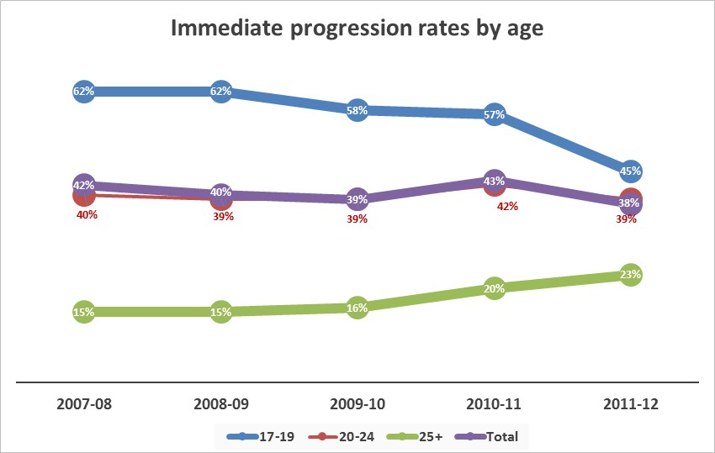
HE progression of London college cohorts by age
YOUNG progression rate fell in 2012 as did progression to prescribed HE courses
ADULT progression rates rose in 2012 as did progression to non-prescribed HE courses

Slide 16
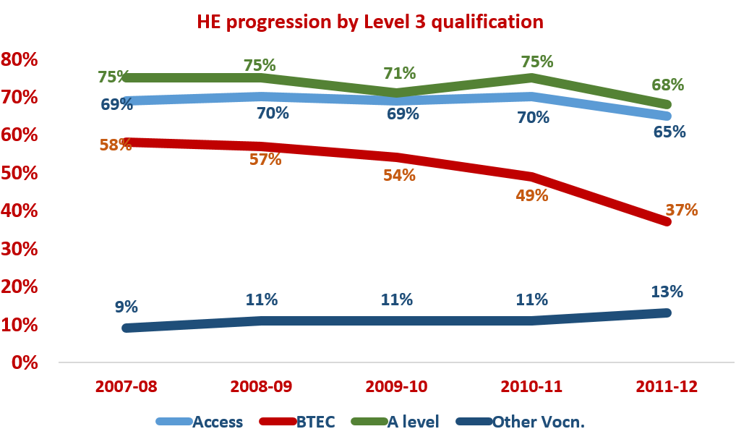
HE progression by qualification
It is likely that the huge increase in BTEC population also contributed to this decrease in rates.

Slide 17
HE in FE in London colleges

Slide 18
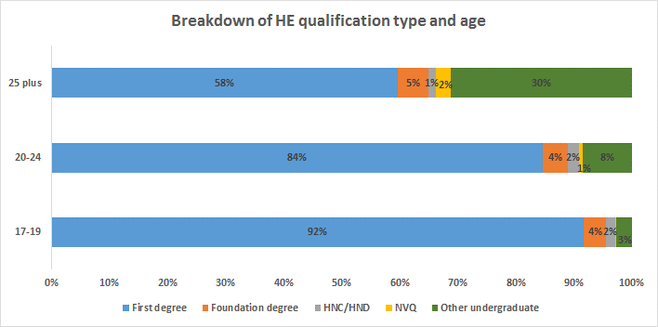
HE qualification progressed to by London college cohorts by age

Slide 19
Ethnic breakdown of London college progressing in 2011-12
Young BME students average HE progression rate higher than Young White students (2011-12 cohort)
51%
33%
BME students
White students
The report includes progression data showing ethnic breakdown by age and FE qualification studied

Slide 20
Top institutions London college students progressed to in 2012-13
HE provider of prescribed HE | 2012-13
Middlesex University | 1230
Kingston University | 935
University of Westminster | 880
University of East London | 790
London South Bank University | 780
London Metropolitan University | 725
University of Greenwich | 710
University of Hertfordshire | 645
University of Bedfordshire | 455
Roehampton University | 405
Brunel University | 385
Coventry University | 370
University of West London | 325
Queen Mary University of London | 310
University of Kent | 285
City University | 270
Non-prescribed HE provider | 2012-13
Barking College | 140
South Thames College | 115
Havering College of FE and HE | 110
The City Literary Institute | 105
Richmond upon Thames College | 95
Ealing, Hammersmith and W London College | 95
College of North West London | 90
Lambeth College | 85
Croydon College | 80
Morley College | 75
Uxbridge College | 70
Waltham Forest College | 70
Harrow College | 65
College of Haringey, Enfield and NE London | 60
Richmond Adult Community College | 60

Slide 21
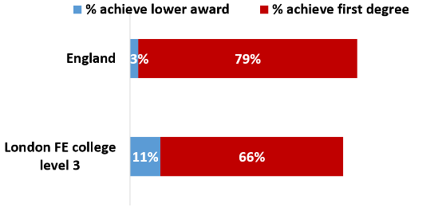
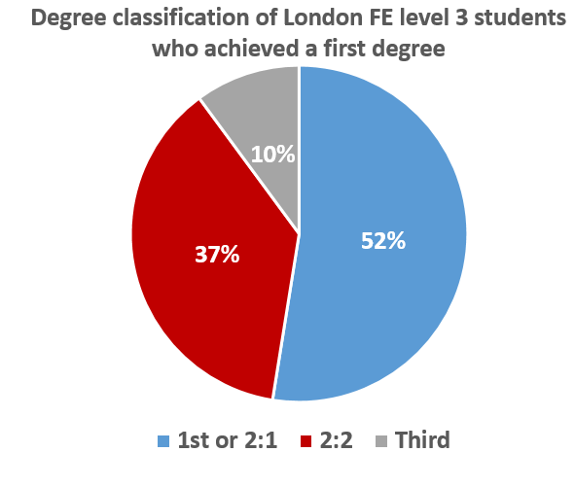
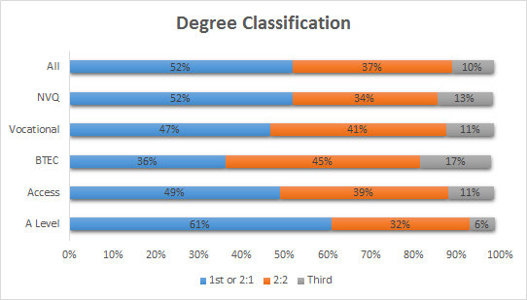
HE success rates
Degree achievement is lower than national rates. More London FE College students achieve a lower award
52% of London college students attain a good degree – this is lower than the 62% national good degree attainment rate

Slide 22
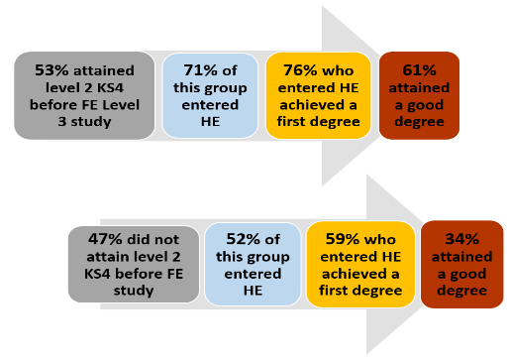
Prior attainment of level 3 college cohort
at Key Stage 4 in school

Slide 23
Conclusions
The London colleges provide an important opportunity for social mobility for students from deprived neighbourhoods in the capital as well as for those with low attainment at school. 15,450 of young students who were low attainers at school entered higher education by virtue of the second chance provided by London colleges. Of these, 60% got First degrees and 34% of them got First or Upper second class honours.
The findings show that of the cohorts of London college students, 77% come from deprived neighbourhoods and 61% are from BME groups. Coupled with the fact that the London colleges provide Level 3 opportunities for students who were low KS4 achievers at school, many of whom go on to progress to HE, this report reveals a significant role the college sector has in the capital as a mechanism for social mobility.

