Slide 1
University of Greenwich Faculty of Education and Health Higher Vocational Education Seminar One Friday 28 Feb 2014 Devonport House, Greenwich, London, SE10 9JW
ESRC HIVE-PED
Welcome and Background
Professor Jill Jameson
Debi Hayes
Professor of Education , University of Greenwich
Director, Centre for Leadership and Enterprise
Professor of Education , University of Greenwich
Notes:
1

Slide 2
Seminar One Welcome and Background

Slide 3
Some contextual factors: * looming election, roles FE, HE, employers * challenges of ££ cuts, global competition * ‘training without jobs’/robbery issues * stratification of elites, social inequity * role of UK-Europe-international models * research of partners: see website

Slide 4
BUT exciting potential of new research, new partnerships
New understandings of higher vocational
key progression and employment issues: longitudinal tracking; data mining
Facilitators of and barriers to progression more identifiable: target removal of barriers
Increased potential for UK-wide and global provider-funder-employer partnerships
Notes:
11:45-11.48
20

Slide 5
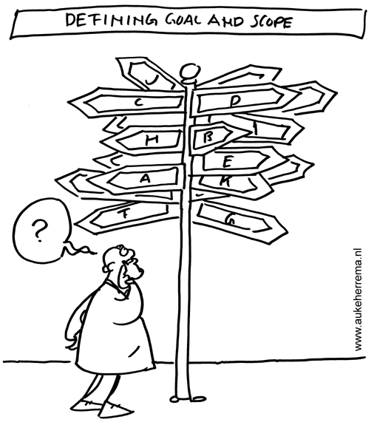
Supporting progression

Slide 6
Strategic thinking/decision making on progression to HE/jobs
Tactical alignment of progression partners
Consider new partnership strategies
Make decisions/goals based on data
Allocate resources to achieve planned goals
Key alliances of progression partnerships
Notes:
11:45-11.48
20

Slide 7
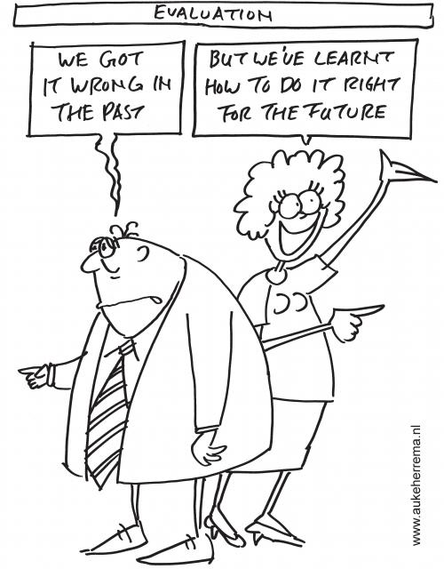
Conclusion
Notes:
12.43
35

Slide 8
Concluding Remarks - Evaluation
What strengths and opportunities identified re.
Journeys to Higher Education? (e.g. Apprenticeships
re. social mobility; FE-HE progression over 5 years;
BME groups in FE; % to FE and % to HEI unchanged)
Learn from data to take forward new strategy
Identify people, resources and tools needed
Deliver key messages for learners and the public
Notes:
12.43 -12.45
36

Slide 9
Recommendations
Further detailed interrogation of data
BIS reports key findings for FECs and HEIs
New partnerships for progression
Funds for further progression research
Enable expansion in learner opportunities
Notes:
37

Slide 10
References
Joslin, H., and Smith, S. (2011). Apprentice Progression Tracking Research Project Report. London: University of Greenwich.
Joslin, H. and Smith, S. (2013). Progression of London College Level 3 Learners to HE. Linking London Research Report.
Joslin, H., & Smith, S. (2013). The Progression of Apprentices into Higher Education. BIS.
King, G., Servais, M., Currie, M., Kertoy, M., Law, M., Rosenbaum, P., Specht, J., Willoughby, T., Forchuk, C., & Chalmers, H. (2003). The Community Impacts of Research Oriented Partnerships (The CIROP Measure). Accessed 17 Oct 2011: www.impactmeasure.org

Slide 11
Jameson, J. (2008) Leadership: Professional communities of leadership practice in post-compulsory education, Stirling University: ESCalate: Discussions in Education Series: HE Subject Centre for Education.
Jameson, J. and Hillier, Y. (2003) Researching Post-compulsory Education. Research Methods Series. London: Continuum.
Evans, K. Schoon I and Weale M. (2013) 'Can Lifelong Learning Reshape Life Chances?' British Journal of Educational Studies. 61, 2.
Francis, B. (2012). Identities and Practices of High Achieving Pupils. London: Continuum.
Fuller, A., & Unwin, L. (2012) Banging on the Door of the University: The Complexities of Progression from Apprenticeship and other Vocational Programmes in England. SKOPE Monograph No. 14 LLAKES Centre, Institute of Education and the University of Southampton

