Slide 1
University of Greenwich Faculty of Education and Health Friday 6th March 2015
ESRC HIVE-PED
Designing a MOOC?
Professor Jill Jameson
Professor of Education , University of Greenwich
Director, Centre for Leadership and Enterprise
Professor of Education , University of Greenwich
Notes:
1

Slide 2
What is a MOOC?

Slide 3
What is a MOOC?

Slide 4
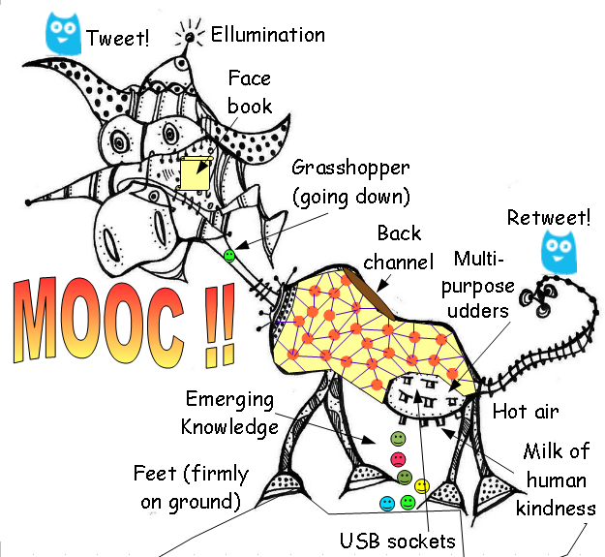
Digital innovation

Slide 5
What is a MOOC?
Massive Open Online Course
* Massive – millions of people can enrol
* Open – anyone can join in freely
* Online – e-learning facilities + tutors
* Course – distributed, networked

Slide 6
Examples of MOOCs
Futurelearn UEA Environmental Justice
Futurelearn Lancaster
Global Food Security

Slide 7
Development of MOOCs since 2011 200+ universities, 1200+ courses 1300+ instructors, 10 million students

Slide 8
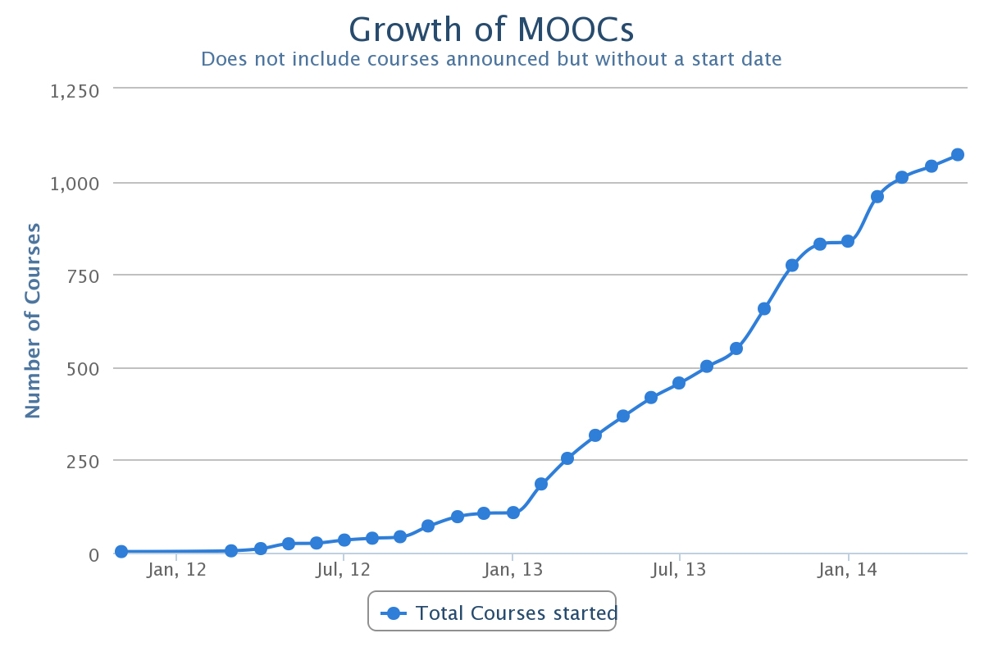
Development of MOOCs

Slide 9
ESRC Series Vision: MOOC on HIVE-PED How should we collaborate on designing a MOOC?

Slide 10
Factors to consider: * educational content/design * impact - reach * platform/timing * partners/funding

Slide 11
Over to you: What other factors should we consider?

Slide 12
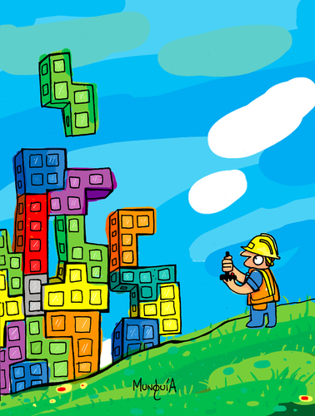
Conclusions: next steps
Notes:
12.43
35

