Slide 1



Vocational Pedagogy in HE
Learning lessons from FE vocational teachers?
Ann Lahiff
Ann.lahiff@ucl.ac.uk

Slide 2
Overview
The challenge for vocational HE (the case of Engineering)
Vocational Pedagogy in Further Education
Insight from Research
Learning lessons from FE vocational teachers
Notes:
I’m going to use Engineering as my example of vocational HE to illustrate some of the challenges currently being faced and to illustrate some responses from HE. This will lead onto an exploration of how vocational pedagogy is understood.
Will draw on my case study research of observations of FE vocational teachers

Slide 3
Challenge for vocational HE
Always been a tension between the demands of higher level study, preparation for entry into an occupation and the requirement to construct programmes of study that are considered ‘fit for purpose’.
Engineering
Recruitment
Attracting wider participation of women
Public perception of what it means to be an Engineer
Progression into Engineering once graduated
Prepared for working in Engineering

Slide 4
Demands on HE Engineering
Royal Academy of Engineering (RAE) : Courses should provide:
… “ the range of knowledge and innovative problem-solving skills to work effectively in industry, as well as motivating students to become engineers on graduation..” Educating Engineers for 21st Century (2007)
… “the right balance between scientific and technical understanding and their practical application to problem solving”. Engineering Graduates for Industry (2010)
By 2014, RAE advocating the development of engineering ‘habits of mind’ (EHoM) which, taken together, describes the ways engineers are seen to think and act.
Notes:
Engineering courses should provide…
ILLUSTRATION of the demands as expressed by the Royal Society of Engineering

Slide 5
Engineering Education Responses
Calls for changes in the traditional, knowledge-led engineering curriculum. For example:
Problem/Project based learning (PjBL) approaches to curriculum design.
CDIO methodology: graduates should be able to Conceive – Design –Implement – Operate complex engineering systems in team based engineering environments to create systems and products
UCL’s Integrated Engineering Project, Sept 2014
Notes:
CDIO initiative came out of MIT in 2000 and has 50 or so participating institutions
Shawcross and Ridgman (2014) : PjBL in Engineering not without problems
See Tilley (2015) for initial evaluation of UCL’s IEP

Slide 6
Changes…
Responding to (employer-led) demand for curriculum development to be ‘fit for purpose’
Level of the curriculum: impact on the way in which teaching and learning managed and facilitated
Consultation / involvement of employers
Has created a growing group of engineering education researchers
However…
Discussion of issues in terms of vocational pedagogy?
What can be learned from Further Education?

Slide 7
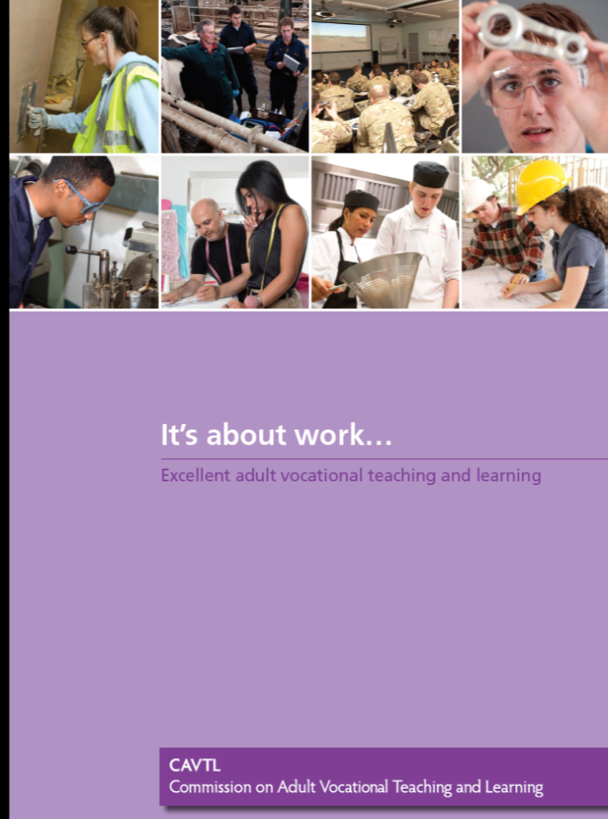

Discussions of vocational pedagogy
Commission on Adult Vocational Teaching and Learning , CAVTL 2013
Methodological approach
The specific connections made to theory
Lucas, Spencer and Claxton, 2012
Notes:
Going to use CAVTL because
It exemplifies a methodological approach which begins from multiple observations of vocational pedagogy in action to develop an understanding of vocational pedagogy
Identifies the underpinning theoretical discussions that need to be addressed in thinking about voc pedagogy.

Slide 8
CAVTL
Rejects
‘learning by doing’, ‘hands on learning’ and ‘practical learning’ to describe both VET and vocational pedagogy:
“ [this] perpetuates the unhelpful dualism of mind as separate from body and suggest that vocational learning needn’t bother itself with the acquisition of underpinning knowledge.”
CAVTL (2013: 34)

Slide 9
CAVTL
“The best vocational teaching and learning combines theoretical knowledge from the underpinning disciplines (for example, maths, psychology, human sciences, economics) with the occupational knowledge of practice (for example, how to cut hair, build circuit boards, administer medicines)…. Both types of knowledge are highly dynamic.”
Vocational pedagogy = the outcome of a process of recontextualisation.
Barnett (2006) Young (2008) Guile (2010)

Slide 10
… for me coming straight from industry, it’s being able to pass on that knowledge that it’s
taken me 25 years to get.
“I could learn about veterinary somewhere else, but it wouldn’t come across as well as hearing it from a vet with his hand up the cow’s backside”
Land-based student: CAVTL
Construction teacher: CAVTL

Slide 11
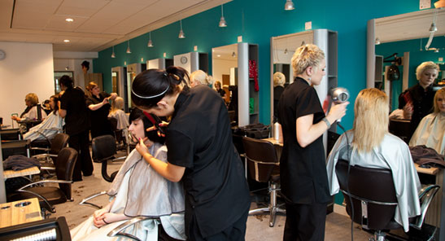
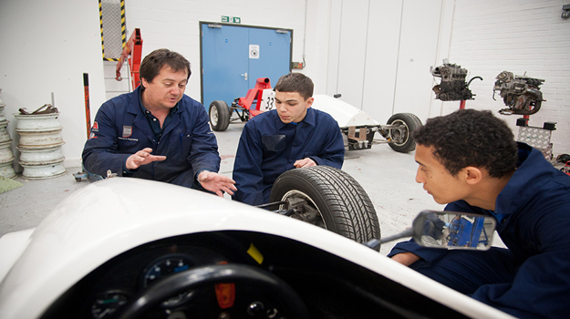
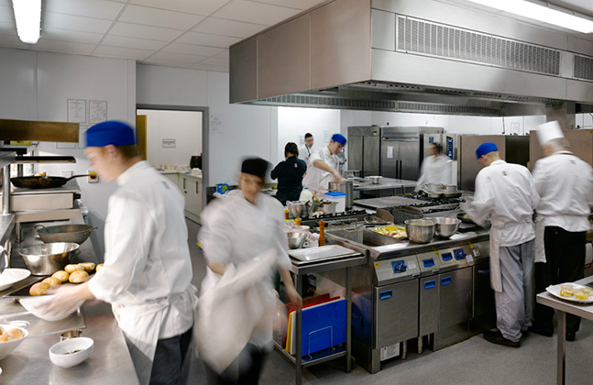
The Research
Use and Value of ITT observations for vocational teachers..
Notes:
Case study observations of practice: see Lahiff (2015) and Lahiff (2016)
VOCATIONAL PEDAGOGY IN ACTION IN CLASSROOMS AND IN SIMULATED ENVIRONMENTS
Catering; Health and Social Care; Wigs and Make-up for Performing Arts; Painting and decorating; Plastering

Slide 12
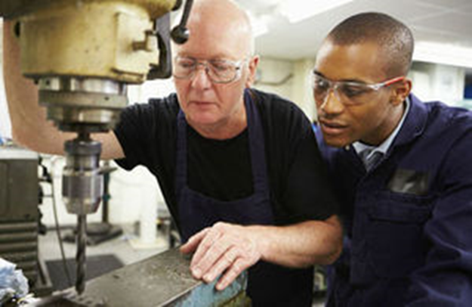
Teachers’ knowledge of and relationship with vocational contexts
Relationships with students enhanced
Credibility ….
Engaged in a process of recontextualisation to make vocational knowledge comprehensible to others.
(Moodie and Wheelahan; 2012)
Vocational Teachers use/introduce the language and cultural practices of the context
Kemmis and Green (2013)
‘…the sayings, doings and relatings’ of occupations..

Slide 13
Importance of context
The vocational environment and its artefacts impact on/create conditions for meaningful vocational pedagogy
Need to recognise the embodied nature of vocational learning: head and ‘heart’.
Work-related attributes are important in transitions…but interpreted in different ways for different vocational contexts.

Slide 14
“There’s no point in letting students take 7 hours or 2 or 3 weeks to make something, because it’s impractical, you know….
It’s like hair styles, when they’re putting rollers in, [I’m saying]…“No girls you’ve got 7 minutes, literally 7 minutes to get a whole head of rollers in; you’ve got 10 minutes to do a blow dry”…
The ‘real work’ imperative informs practice
Notes:
Wigs and Make-up for Performing Arts

Slide 15
Vocational Pedagogy
Learning lessons from FE
NOT prescriptive. Not processed-focussed; Not one size fits all....but with vocational context at its heart.
Frame discussions around the development of HE Vocational Pedagog(ies).
Teachers’ knowledge of/ connections with the occupation means pedagogic process is knowledge-rich.
The ‘real work’ imperative informs practice. Employers’ role.
Situated learning
Attributes for higher level vocational learning also situated : interpreted in different ways for different occupations.

Slide 16
References
Barnett, M. (2006) ‘Vocational Knowledge and Vocational Pedagogy’, in Young, M.F.D. and Gamble, J. (eds) Knowledge, Curriculum and Qualifications for South African Further Education, Pretoria: Human Sciences Research Council Press
Guile, D. (2010) The learning challenge of the knowledge economy. The knowledge economy and education . Sense, Rotterdam
Kemmis Ros Brennan (AM) & Annette Green (2013) Vocational education and training teachers’ conceptions of their pedagogy, International Journal of Training Research, 11:2, 101-121
Lahiff, A. (2015) Maximizing vocational teachers’ learning: The feedback discussion in the observation of teaching for initial teacher training in further education, London Review of Education 13 (1) 3-15
Lahiff, A. Maximising vocational teachers’ learning through developmental observation, in O’Leary, M. (Ed) Reclaiming Lesson Observation, Chapter 4 (forthcoming), Routledge.
Moodie, G., and Wheelahan, L. (2012) ‘Integration and fragmentation of post compulsory teacher education’ Journal of Vocational Education and Training, 64 (3), 317–31.
Royal Academy of Educating (2007) Engineers for 21st Century, RAE
Royal Academy of Educating (2010) Engineering Graduates for Industry, RAE
Royal Academy of Educating (2014) Thinking like an Engineer: implications for the education system, RAE
Shawcross, J.K and Ridgman, T. W. (2014) Short industrial placements – developing an activity framework to support teaching and learning, Higher Education, Skills and Work-based Learning,. 4 : 3 pp. 256 – 270
Tilley, E. (2015) Pedagogic experiences in problem-based learning environments focused on human-centred design Conference presentation, SEFI 2015
Young, M.F.D. (2008) Bringing Knowledge Back In, London: Routledge

